Slide 1
Floopy bird game Design

Slide 2
How To play ?
The game has a main frame and in the main frame there is a button to start the game
After the user pressed the button it takes the user to the game loop
Once in the game loop, the user is required to press the space key to make the bird flock and carefully flock the bird through the panels
If the user wishes to pause the game, the user must press the “P” key.

Slide 3
Cont…
To resume the game the user must press the “R” key.
To restart the user must press the “S” key.

Slide 4
Risks
Technical complication
Keeping users playing for large periods of time
User experience– making the game enjoyable for all kinds of people
Time management

Slide 5
Date Model
Press “S”
Press “R” Press “P”
Yes No
Game start
Game restart
Game Resumes
Game paused
Game loop executes
Score increments every 3 seconds
Is the flocking ?
Bird falls off screen
Bird hits Pipe
Game Over

Slide 6
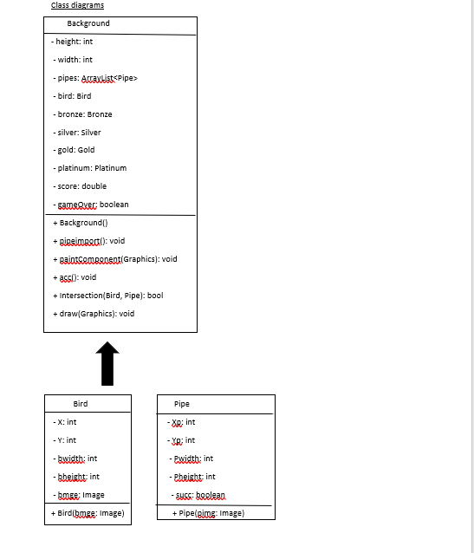
F

Slide 7
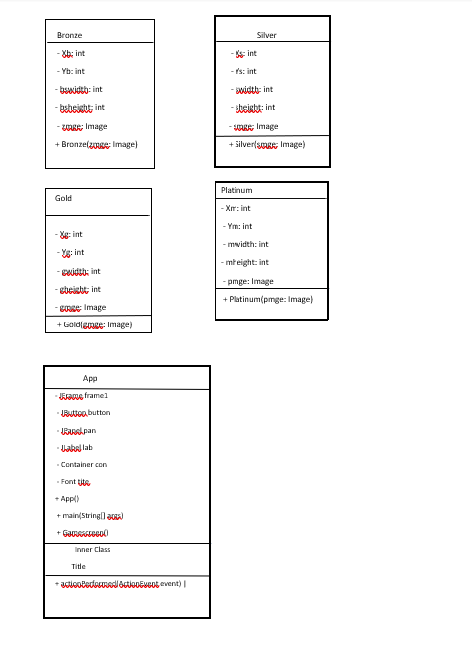
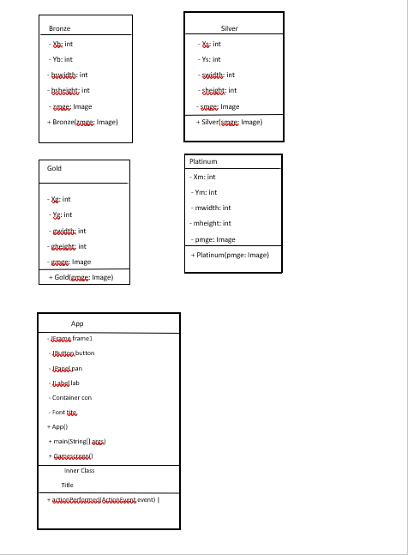

Slide 8
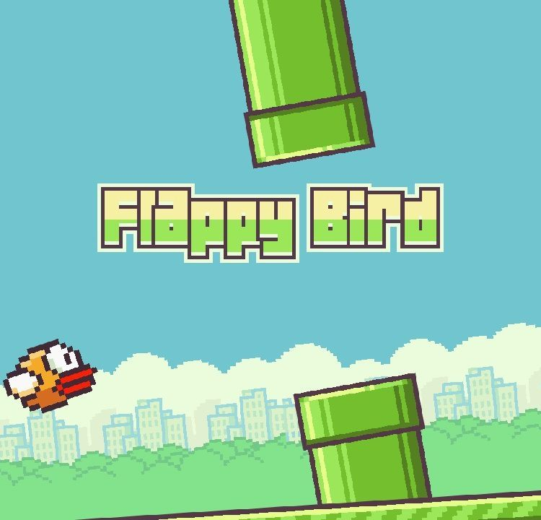

Main Frame

Slide 9
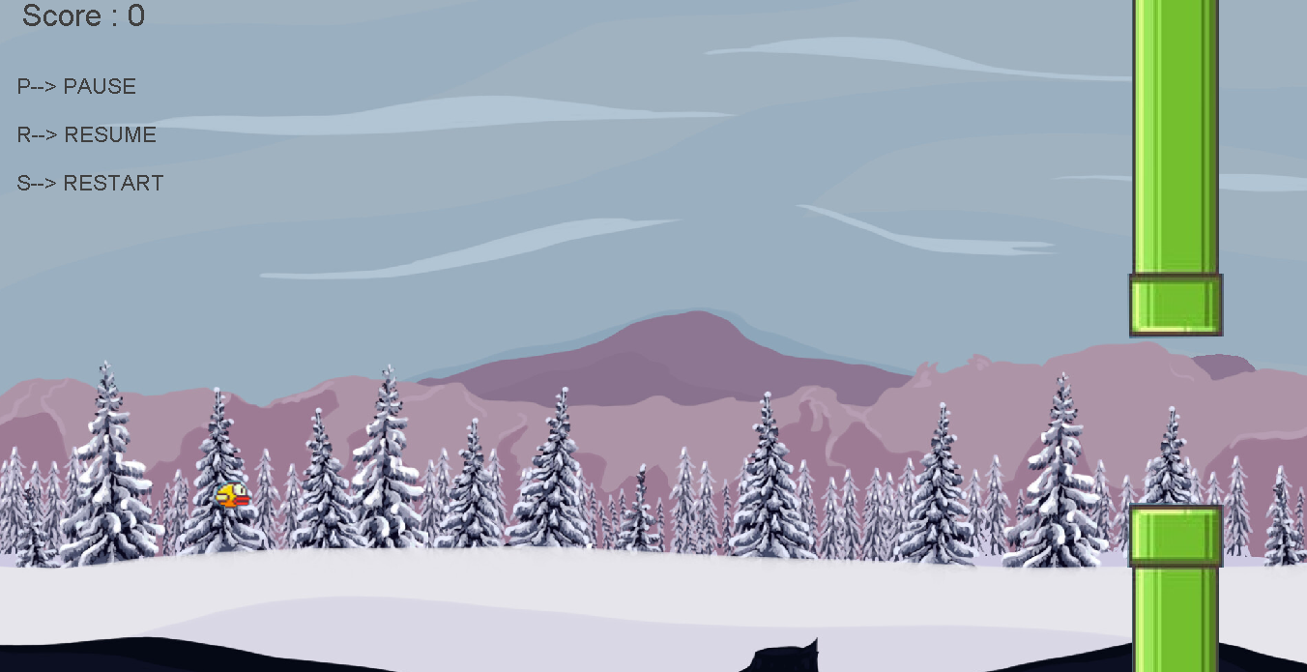
Game loop

Slide 10

Game ends

